Slide 1
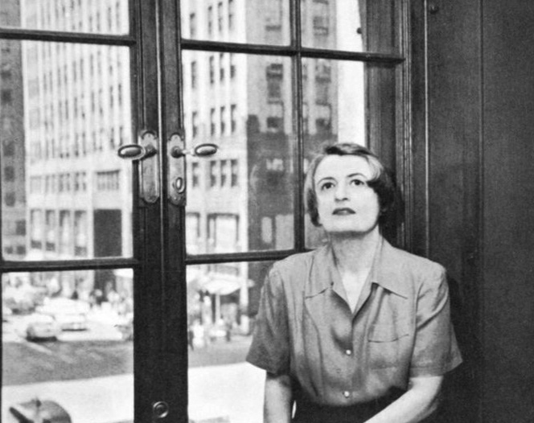
Objectivism for Lefties
A personal look at the life and writings of Ayn Rand
Notes:
It was interesting for me to read a message sent to the HL email list regarding someone’s concern for this talk proposal and how they felt that having such a talk on the roster made it hard to imagine it would be a nice environment and that they hoped the event organisers would step in and see some sense.
I would like you to consider what it might be like for me to propose such a talk, keep it on the schedule and stand here in front of you and deliver it. I am hoping with open minds and heats, intelligent heads, and mutual respect we can keep this a nice environment, which HL has always been thus far.
I would appreciate if we could do questions and points at the end if there’s time, or afterwards if not. Thank you

Slide 2
Why talk about this?
I am interested in different ways of (philosophical and political) thinking, especially when they challenge my own thinking
I believe in dissent
I feel this helps me to better understand the World, its history, and its people
Rand is generally disliked, dismissed or discredited by the Left; me being a contradictory soul, this sparked my interest!
I have a desire to avoid ideological siloes
Notes:
I am not an Objectivist.
I consider myself to be anti-authoritarian, republican, anarchist and libertarian leaning.
I am not a socialist, although I do believe in the welfare state and nationally-run natural monopolies, because they are necessary for all people in society.
I normally vote Green, for what it’s worth.
I believe in dissent.
I am interested in different ways of (philosophical and political) thinking, especially when they challenge my own thinking.
This helps me to understand the World, it’s history, and it’s people, better.
Indicate points I agree with, if interpreted a certain way, that I feel is applicable to all humans (selfishness, egoism, self-interest)
Look at the impact on thinkers of aging and realising that they cannot change the World: the disillusionment (for example, this impacts climate activists – that guy who went to Cop-15 in 2009, etc)
Glomming - the act of being stuck or attached to (in this case an idea) - it also means to steal

Slide 3
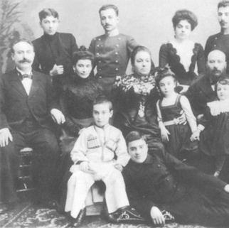
Background & context
Alisa Zinov’yevna Rosenbaum (Алиса Зиновьевна Розенбаум)
February 2nd 1905 in Saint Petersburg (Санкт-Петербург)
Zelman Wolf “Zinovy” Zakharovich Rosenbaum, her father, was a pharmacist, born in the Pale of Settlement.
Her mother was Khana Berkovna “Anna” Kaplan qualified as a dentist, was a socialite from the bourgeoisie.
Analysing her behaviour and approach to the World there is good reason to believe she was in the Autism Spectrum (see https://veridici.com/ayn-rand-had-aspergers-syndrome/)
Notes:
I feel it’s important that we consider the period in history and the context in which someone was born, lived and wrote in order to understand them better. Her father, Zinovy, was born poor in The Russian Pale of Settlement, an area where Jews were allowed to live. St Petersburg, which would later be renamed to Petrograd, then Leningrad under the Soviets, was, at the time, the most Jewish-tolerant of all the Russian cities, but even then, Jews could only settle there if they had a valuable profession. For this reason Alisa’s father studied pharmacy in order to move there. Alissa’s mother had studied ??? but, following Alissa’s birth, became a mother and socialite. She was from a bourgeoise family and several of her relatives lived in the same area of Petersburg. Therefore Alissa grew up in a very Jewish enclave.
during the time of the Czarist Russian Empire to a Russian-Jewish bourgeoise family the eldest of three daughters.
She was born just one month after the 1905 revolution, when Czar Nicolas’ 12,000 men opened fire on 30,000 factory worker, their wives, children, labour representatives and students. The family lived on Zabalkanskii Prospekt, where on the same evening as the January massacre, Maxim Gorky would announce to a group of the city’s liberals and intellectuals that “The Russian Revolution has begun”.
She was the eldest amongst her sisters, Natasha and Elena. Her father Fronz had owned a chemist shop, while her mother Anna, who had trained as a dentist, was Alisa’s opposite, an active socialite. “She was by principle and basic style… extremely social… she was much more interested in the social aspect.” Ayn Rand thought such activities to be of little value.
Saint Petersburg later to be Petrograd later still to be Leningrad.
Alisa Zinov’yevna Rosenbaum (Russian: Алиса Зиновьевна Розенбаум) was born on February 2nd, 1905 in Saint Petersburg during the era of Tsarist Russia. It was during her youth that she witnessed enraged and starving workers/peasants joining the Bolshevik Revolution in Russia. The period of a constitutional monarchy permitting some freedoms was quickly and violently overthrown, replaced by Communism.
Alisa was a curious child and a fond reader of a French serial about a heroic detective who was in pursuit of a jewel thief. To Alisa, this was a story of a battle between good and evil. This was to be the perspective from which she viewed the world. In her writing, she later transformed the battle between good and evil into a struggle of opposing ideas on a global scale: the good versus evil motif remained.
Her conflicts with her mother, Anna, were many in her younger years, with Alissa seething at the seeming random injustice of her mother’s judgment. Story about the toys here.
I feel some sympathy for her position, having experienced this myself. I myself have developed an anti-authoritarian stance all my life. I dislike irrationality and unjustified decisions.

Slide 4
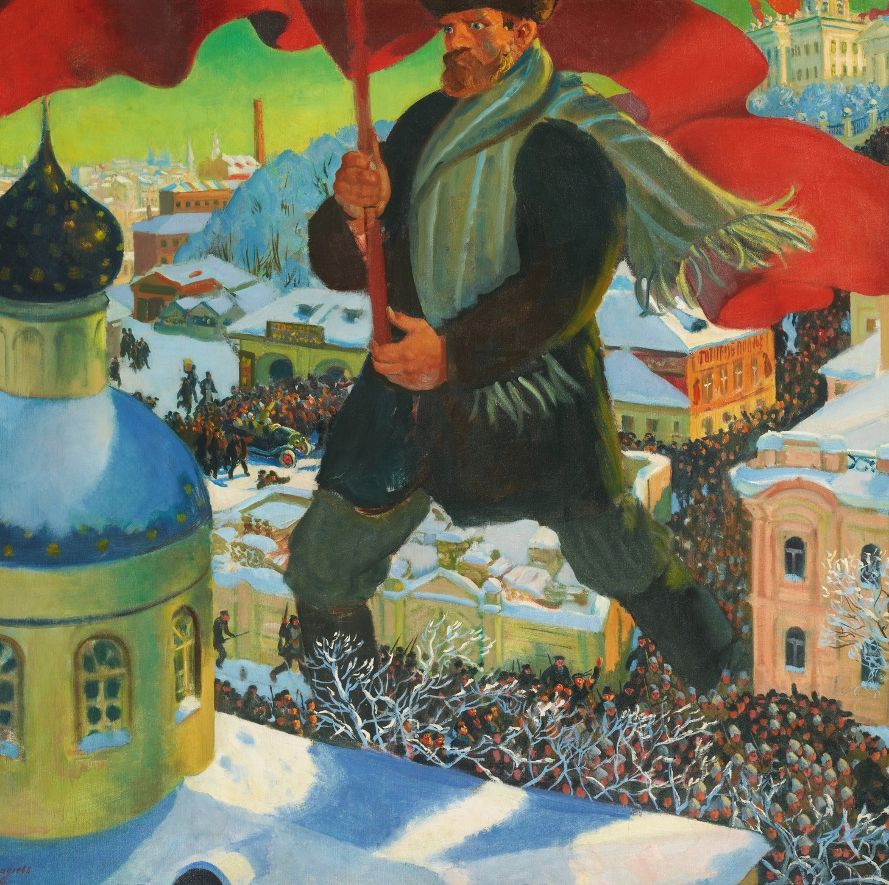
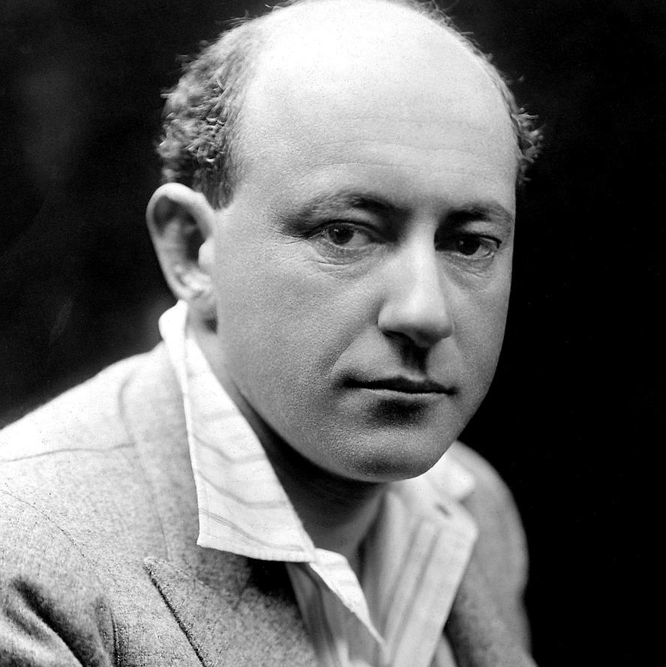
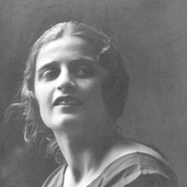
Background & context: the (1917) October Revolution
Under Lenin and the Bolsheviks her family’s business was seized and the family fled to the Crimea, at the time still under the control of the White Army.
Returned to Petrograd in 1921 and enrolled in Petrograd State University to do social pedagogy, one of the first women to do so.
As a student from a bourgeoise background she was purged from the university by the Bolsheviks.
She was reinstated and left Leningrad State University in 1924
Studied at State Technicum for Screen Arts and published Pola Negri as an essay
Granted a visa to visit family in Chicago and arrived in NYC in Feb 1926
Started her working life in LA for Cecille B. DeMille
She never returned to Russia and was unable to bring her parents an family to the US
Notes:
Pola Negri (/ˈpoʊlə ˈnɛɡri/; born Barbara Apolonia Chalupec^{[a]} [apɔˈlɔɲa xaˈwupɛt͡s]; 3 January 1897^{[b]} – 1 August 1987) was a Polish stage and film actress and singer. She achieved worldwide fame during the silent and golden eras of Hollywood and European film for her tragedienne and femme fatale roles and was acknowledged as a sex symbol.
Cecil Blount DeMille (/ˈsɛsəl dəˈmɪl/; August 12, 1881 – January 21, 1959) was an American film director, producer, and actor. Between 1914 and 1958, he made 70 features, both silent and sound films. He is acknowledged as a founding father of American cinema and the most commercially successful producer-director in film history.
DeMille directed The King of Kings (1927), a biography of Jesus, which gained approval for its sensitivity and reached more than 800 million viewers. The Sign of the Cross (1932) is said to be the first sound film to integrate all aspects of cinematic technique. Cleopatra

Slide 5





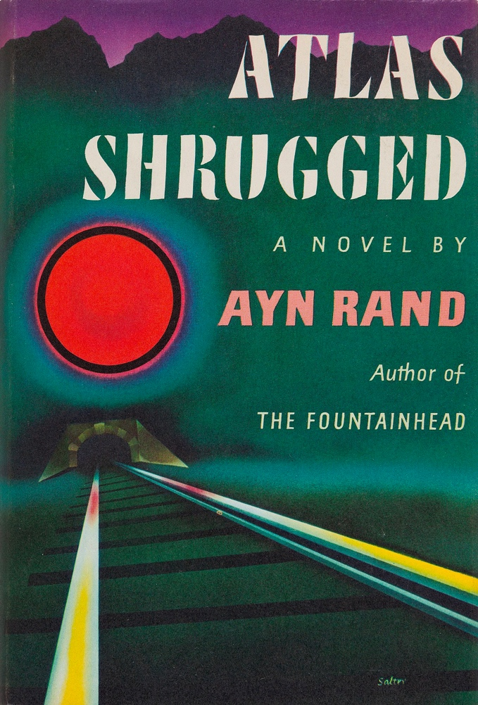

Her novels & plays
Notes:
AR described her work as “Romantic Realism” – describing the world as it should be, not as it was.
Strong female characters, most often involved with more than one man (as she herself was with Nathaniel Brandon)
Protagonists, male and female, are heroic, individualists, depicted as fit and attratictive
Villains support collectivist moral ideals and duty.
The Fountainhead – 1943 -
Atlas Shrugged – 1957 – mention Galt’s Gulch
Anthem – 1938
We the living – 1936 – play as the Unconquered
Pola Negri ~ 1924
The night of January 16th – play 1934, published 1968
Ideal – written 1936, published 2015
Readings from each:
“The Fountainhead” – standing on the cliff
“We The Living” – her sister’s statement
“Anthem” – unsure
“Atlas Shrugged” – the train crash

Slide 6
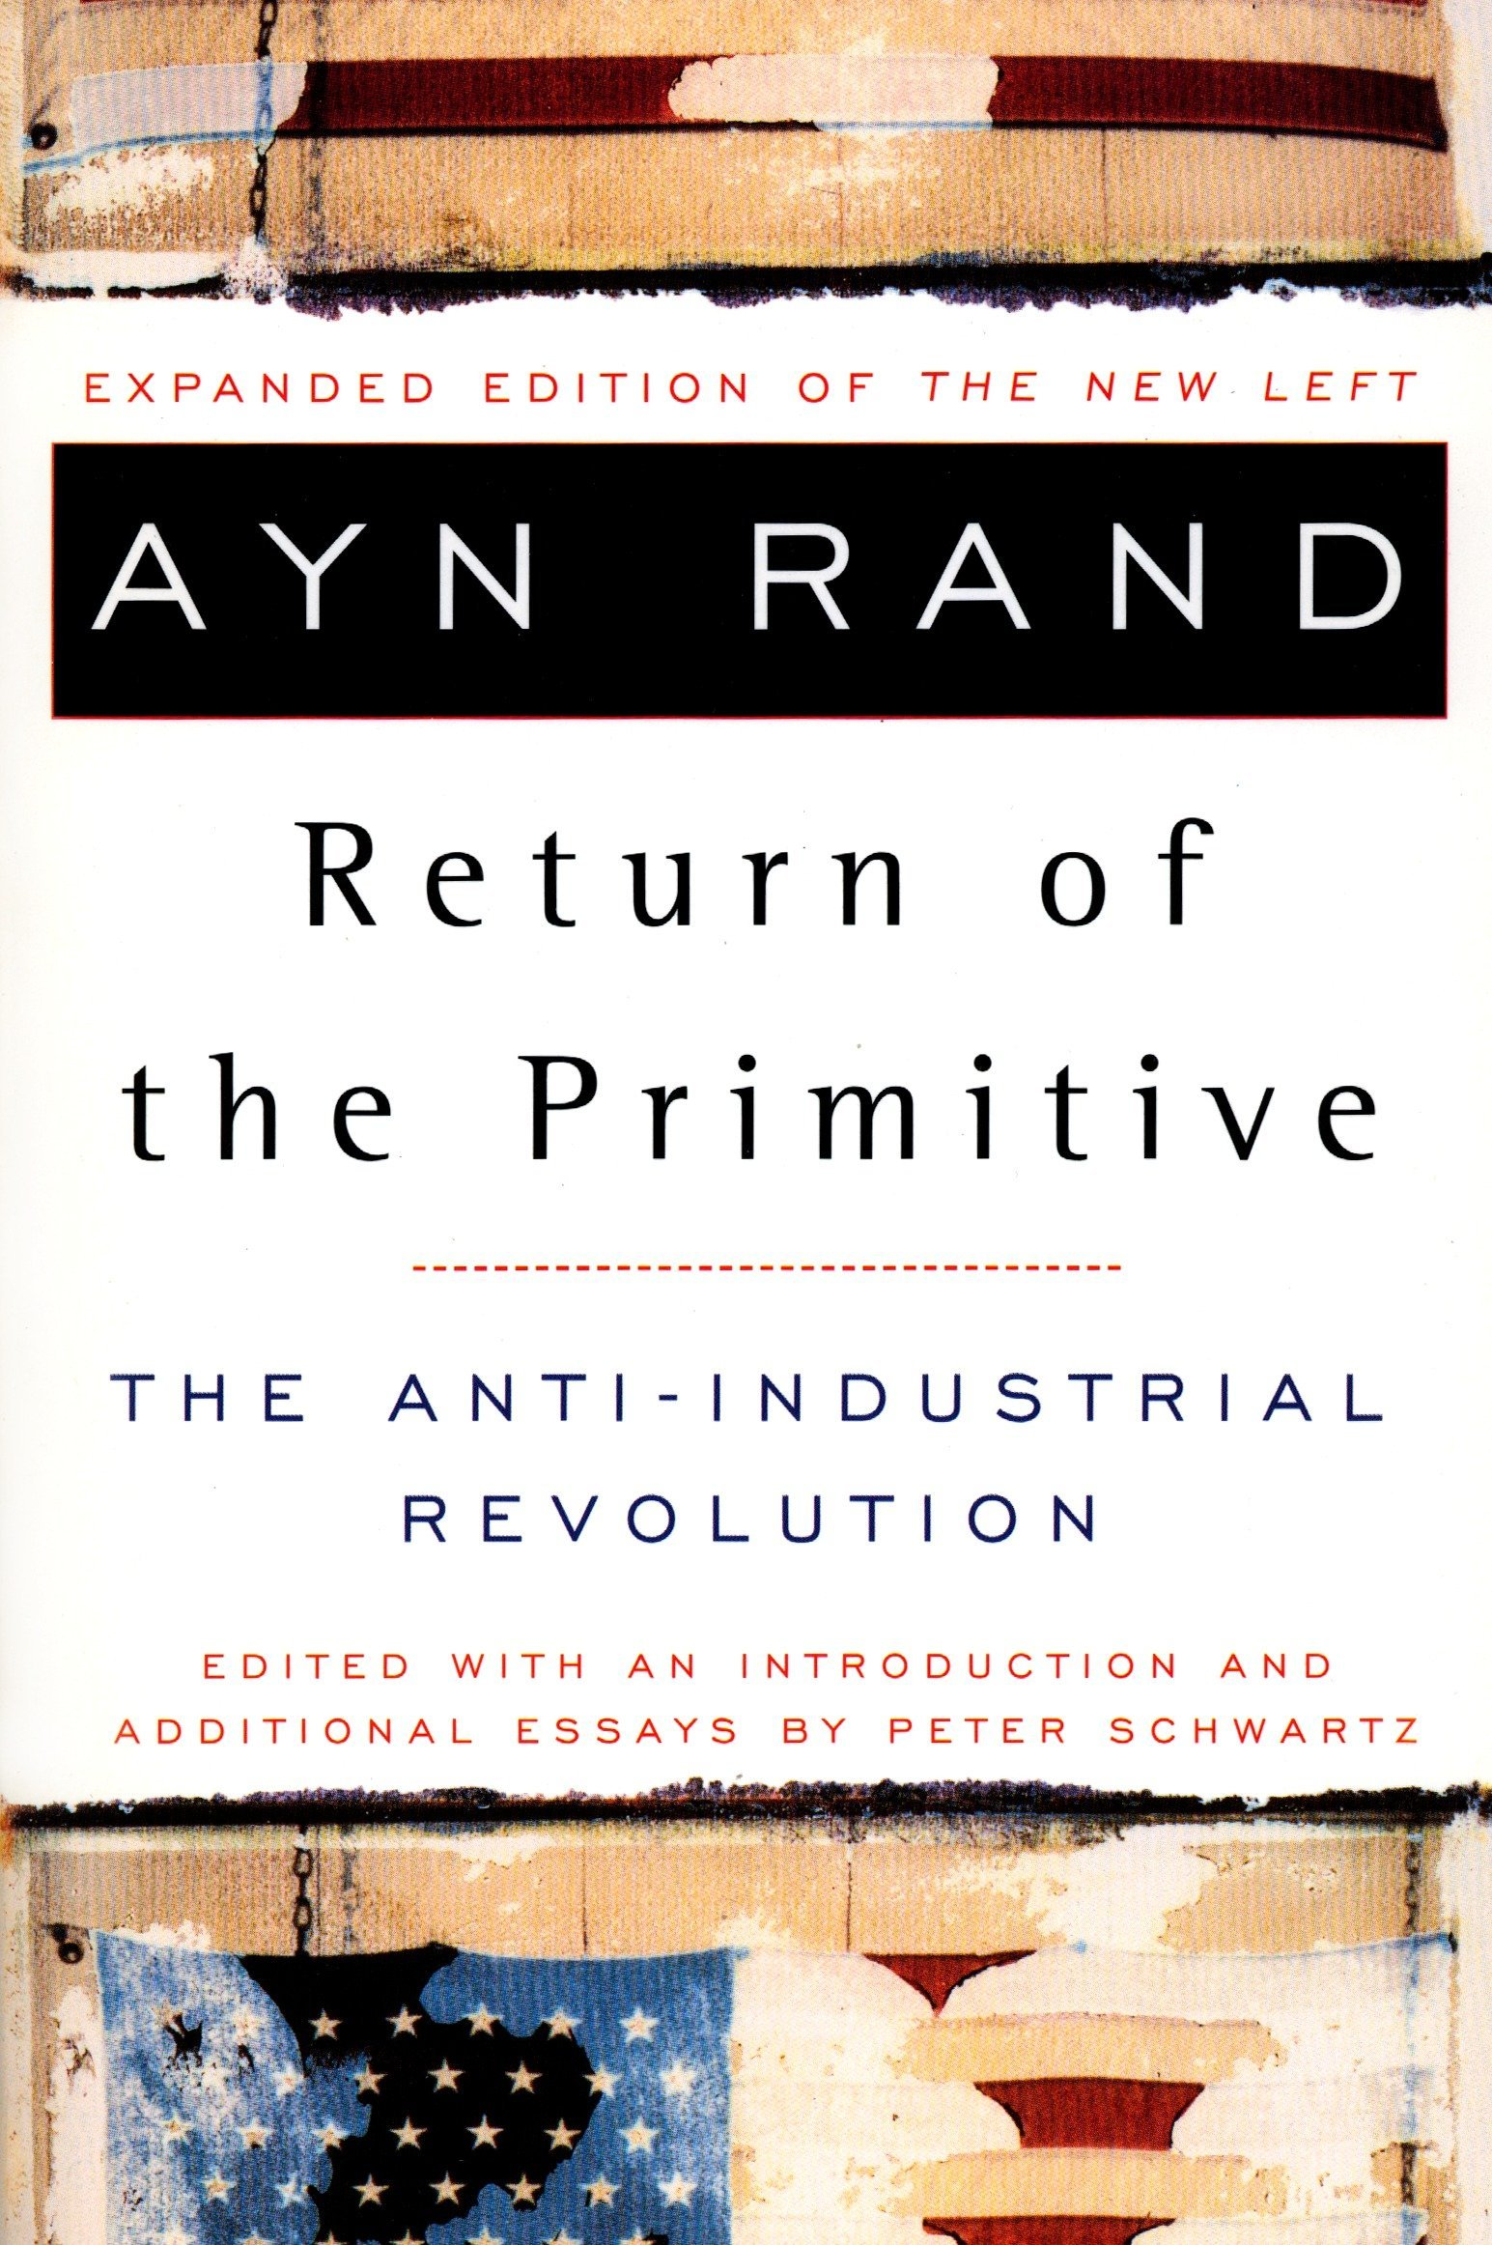



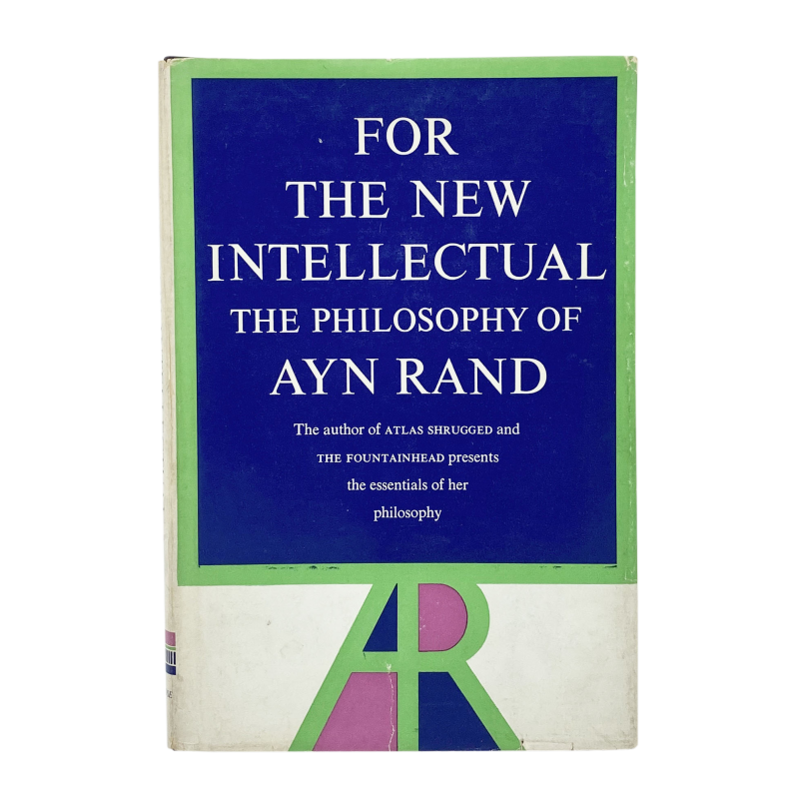
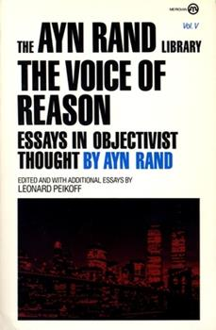

Her philosophy & writings
Notes:
The Voice of Reason
For the New Intellectual
The Virtue of Selfishness
An Introduction to Objectivist Epistemology
Capitalism: the Unknown Ideal
Return of the Primitive
The Romantic Manifesto

Slide 7
Beliefs: Overview
Opposed to collectivism, anarchism, statism, socialism
Though her opposition to anarchism is at maybe at odds with her general belief perhaps…
Fan of Aristotle, Thomas Aquinas, and other classic liberals
She read Dostoevsky, Rostand, Schiller
Disliked Kant calling him "the most evil man in mankind's history” and the “destroyer of the modern world”
From my inexpert eye, objectivism seems to be a friend of the rationalisms movement of John Locke and David Hume
Notes:
Anti-statism vs Statist. Although this could be argued to be anti-imperialist (Russian, German).
Appears to be anti-Socialist, but really I feel it’s anti-coercion, opposes doing something to appease one’s own conscience, assuage one’s guilt, make one feel better about oneself, rather than accepting one’s self, one’s actions and behaviour.
Anarchism is a political philosophy that advocates stateless societies characterized by self-governed, non-hierarchical, voluntary institutions.
Her hate of Kant was primarily due to his rejection that one could perceive reality, thereby destroying the basis of all knowledge.

Slide 8
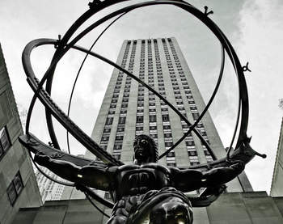
Objectivism
A is A or what exists, exists

Slide 9
Objectivist Ethics
“My philosophy, in essence, is the concept of man as a heroic being, with his own happiness as the moral purpose of his life, with productive achievement as his noblest activity, and reason as his only absolute.”
“Objectivism holds [a] man’s life as the standard of value, and his own life as the ethical purpose of every individual man.”
“The actor must always be the beneficiary of their action and that they must always act for their own rational self-interest.”
“Man’s right to exist for his own sake, for his own self-interest
[does not grant] his right to sacrifice others. It is not a license to ‘do as he pleases’.“
Notes:
Man must choose his actions, values and goals by the standard of that which is proper to man – in order to achieve, maintain, fulfil, and enjoy that ultimate value, that end in itself,
which is his own life.

Slide 10
Objectivist Values and Virtues
The three values: Reason, Purpose, and Self-Esteem
Their three corresponding [major] virtues: Rationality, Productiveness, and Pride
And the four [minor] virtues: Independence, Integrity, Honesty, and Justice
Notes:
Man must choose his actions, values and goals by the standard of that which is proper to man – in order to achieve, maintain, fulfil, and enjoy that ultimate value, that end in itself,
which is his own life.

Slide 11
Objectivist Virtues
Rationality: recognition and acceptance of reason as one’s only source of knowledge, one’s only judge of values, and one’s only source of action.
Productiveness: recognises that productive work is the process by which one’s mind sustains one’s life. Productive work being the consciously chosen pursuit of a productive career, however modest.
Pride: as man is a being of self-made wealth, so he is of self-made soul. One’s response to one’s power to achieve values, the pleasure one takes in one’s own efficacy.
Independence: acceptance of the responsibility of accepting one’s own judgements and living by the work of one’s own mind.
Integrity: one should never sacrifice one’s convictions to the opinions nor wishes of others.
Honesty: one must never attempt to fake reality in any manner.
Justice: one must never seek nor grant the unearned nor undeserved, neither in matter nor spirit
Notes:
The irrational is that which contradicts the facts of reality. Facts cannot be altered by a wish, but they can destroy the wisher.
Pride is what mystics hold as evil.

Slide 12
The Virtue of Selfishness
Selfishness: the quality or state of being selfish : a concern for one's own welfare or advantage at the expense of or in disregard of others : excessive interest in oneself – Merriam-Webster
In popular usage, the word “selfishness” is a synonym of evil; the image it conjures is of a murderous brute who tramples over piles of corpses to achieve his own ends, who cares for no living being and pursues nothing but the gratification of the mindless whims of any immediate moment – Ayn Rand
Selfishness: concern with one’s own interests – Ayn Rand
Self-interest: a concern for one's own advantage and well-being; one's own interest or advantage – Merriam-Webster

Slide 13
The Virtue of Selfishness: Looters
If some men attempt to survive by means of brute force or fraud, by looting, robbing, cheating or enslaving the men who produce, it still remains that their survival is made possible only by their victims, only by the men who choose to think and to produce the goods which they, the looters are seizing.
If some men do not choose to think, but survive by imitating and repeating … never making an effort to understand their own work, it still remains true that their survival is made possible only by those who did choose to think and to discover the motions they are repeating.
Man’s right to exist for his own sake, for his own self-interest
[does not lead to] his right to sacrifice others. It is not a license to “do as he pleases”.
Notes:
This is key to understanding what she is saying: which is that she is not justifying looting, robbing anyone else, but also not imposing any external ”ethic”, any concept of “good” and “evil” on anyone else.

Slide 14
Egoism
Egoism: a doctrine that individual self-interest is the actual motive of all conscious action; a doctrine that individual self-interest is the valid end of all actions; excessive concern for oneself with or without exaggerated feelings of self-importance – Merriam-Webster
Egoism: a doctrine that individual self-interest is the actual motive of all conscious action; a doctrine that individual self-interest is the valid end of all actions; excessive concern for oneself with or without exaggerated feelings of self-importance – Ayn Rand
Egotism: excessive use of the first person singular personal pronoun; the practice of talking about oneself too much; an exaggerated sense of self-importance – Merriam-Webster

Slide 15
Rand on this and that
“Dragons don’t exist however sincere the belief that they do”

Slide 16
Trade
Trade: The only rational ethical principle for all human relationships, personal and social, private and public, spiritual and material.
Trade: The act of dealing between humans who do not desire the unearned, who do not make sacrifices nor accept them, but rather exchange Value for Value.
Trader: someone who treats fellow humans as independent equals; who does not treat humans as masters nor slaves; who earns what he gets and does not give or take the undeserved.

Slide 17
Trade + Spirituality => Acceptance
Trade: in spiritual (pertaining to a person’s consciousness) terms is the currency is love, friendship, respect, admiration given in return for the virtue of another’s character.
Self-acceptance: A willingness to be true to oneself.
Mutual-acceptance: radical honesty, rational love, relationship anarchy.
Individualism: in this context therefore means an internal recognition and acceptance of who one is themselves, and a living of life true to that recognition. This also requires an acceptance of others’ individualism.
Individualism: some more recent social trends result in individualism that seems to be more about having the outside world forcibly accept one’s own internally created self-image. This is more about coercion, laying trips on people, and the tyranny of the self.
Notes:
Spiritual - pertaining to a person’s consciousness
Here Rand is using the term individualism to mean the only moral or ethical judgment of some is of them as them, as an individual, whose purpose in life is to action in accordance with their own self-interest.
Trade in spiritual terms is the currency is love, friendship, respect, admiration given in return for the virtue of another’s character. This feels very healthy to me, and along the lines of Eric Bern’s desired game-free relationships, so no playing of “If it weren’t for you”, “Look what you made me do”, “I’m only trying to help you” etc. I absolutely concur with this approach of radical honesty, or rational love, relationship anarchy.
If I give money to charity or a homeless person because I feel I should, or because I feel guilty, and by doing so I assuage those feelings, that isn’t honest. I should give because I want to, because I want to, or because I support the person who asks for it, is doing the marathon. This is in the same way I should not tell someone I love them to make them feel better, or to assuage my guilt because I no longer love them or fancy them or because I fancy another. I should tell them this because I admire them, respect them, or actually love them.

Slide 18
Capitalism
Capitalism: an economic system characterized by private or corporate ownership of capital goods, by investments that are determined by private decision, and by prices, production, and the distribution of goods that are determined mainly by competition in a free market - Merriam-Webster
Capitalism: profit by any means – Common left-wing interpretation
Capitalism: the right to profit whilst upholding the rights of others to their own self-interest – Ayn Rand (my definition)
Notes:
Leading from this rationalist view of spiritual trade and the definition of individualism, capitalism therefore becomes the economic aspect of Rand’s way of thinking. Only laizez-faire capitalism provides for treating people as themselves and respecting their own rights. Noting with this again, that this is a pure ideological form, not the form where people are abused, exploited, bullied and murdered for the profit of someone else. The point here is that that behaviour isn’t necessarily intrinsic to capitalism but is a human trait that can appear in many different economic systems.
Often defined by the left as ”profit by any means”.
Under Rand’s definition though it would be something like “the right to profit whilst upholding the rights of others to their own self-interest”.
Therefore this doesn’t imply rampant exploitation at the expense of others, because, if this were the case, then the exploiter would also loose their own rights.
In short “don’t screw people over in order to obtain profit”
Profit = value created by work less costs of doing the work
Given that Rand’s basis for Individualism is internal
Is employing people tyrannical?
In theory employment involves a contract between the employer and the employee. Rand’s argument would be it is both parties free will and right to enter into this contract, and it is the responsibility of a government to uphold the contract.
Rand’s rather utopian view of Laissez-faire Capitalism, doesn’t in practice really exist, because it relies on the covenant of non-exploitation of others, of upholding their rights. It is therefore not as the common definition of capitalism that anti-capitalists think.
Thus, in both the case that she riles against – collectivism, socialism – and the systems that she champions/expounds, the core failing is second-handers, people who exploit the system and others to their own benefit without doing any work themselves, thus leading to a form of tyranny over the worker.
This is just the same in mis-managed exploitative LFC as it is in previous collectivist experiments, and, to a degree, some socialist systems.

Slide 19
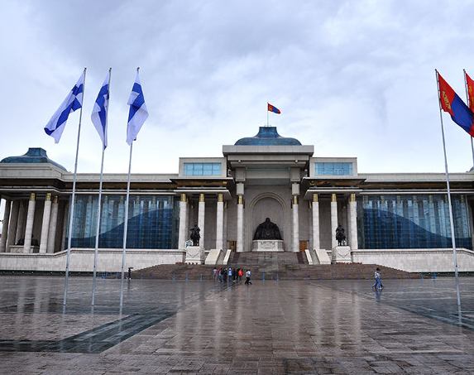
The rôle of Government
“The only proper, moral purpose of a government is to protect man’s rights, which means: to protect him from physical violence - to protect his right to his own life, to his own liberty, to his own property and to the pursuit of his own happiness." (Without property rights no other rights are possible)
“No society can be of value to a [person’s] life if the price is the surrender of his right to life.”
“No human may initiate the use of force against others.”
Notes:
This statement sums up her objection to coercion and her championing of one of the only valid purposes of a government is to uphold a person’s right to freedom. Having grown up during Tsarist Russia and the various revolutions she saw first-hand how peoples’ right to life were compromised by tyrannical governments, both before, during and after the October Revolution.
Her premise was that the government through a police force should be granted the ability to enforce only these characteristics.

Slide 20

Feminism
“An embryo has no rights. Embryo rights is an elevation of potential life over actual.”
“The notion that a woman’s place is in the home… is an ancient, primitive evil, supported and perpetrated as much by women as by men”
“Feminists elevate their gender above their individuality and intelligence and then expect unearned success to be enforced by government.”
Notes:
Professional paid work for women as opposed to traditional roles
Saw feminism as a collectivist/Marxist making women as a new opposed class with to be redressed by government.

Slide 21

Environmentalism
“Clean air is not the issue nor the goal of the ecologists’ crusade.. It is technology and progress that the nature-lovers are out to destroy” – Ayn Rand
Notes:
Rand again focusses narrowly on one faction of “conservative environmentalism” which emphasizes the dangers of technology and is resolutely anti-growth.
This style of environmentalism is in contrast with pragmatic or countercultural environmentalism, which focusses on invention and innovation.
Transhumanism - Julian Huxley (brother of Aldous) - Transhumanist thinkers study the potential benefits and dangers of emerging technologies that could overcome fundamental human limitations, as well as the ethics^{[3]} of using such technologies. Another topic of transhumanist research is how to protect humanity against existential risks, such as nuclear war or asteroid collision.

Slide 22

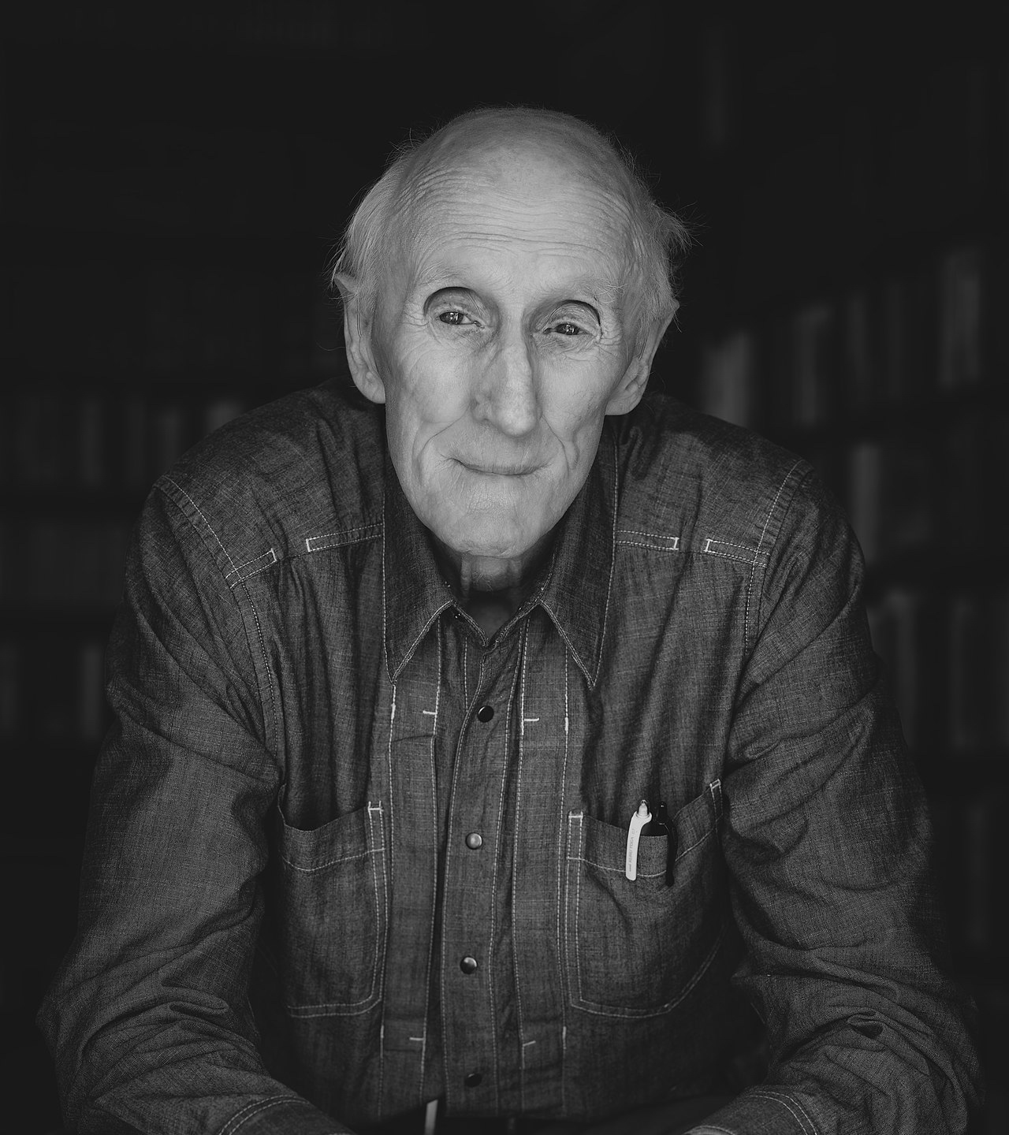
Influence on Silicon Valley
“We are as gods. We might as well get used to it” - Stewart Brand (Whole Earth Catalog)
Notes:
Stuart Bland and the Whole Earth Catalogue, Merry Pranksters, etc. Effect on Jobs, et al.
There was some attempt to align the libertarian/objectivist movement with the New Left in the 1970s, as a lot of the ‘freedom’ orientated causes were the same – draft abolition, immediate withdrawal from Vietnam, equal rights for women, legalisation of gayness, porn, marajana, opposed to domestic statism – but the dividing line was the former supported capitalism.
Joke: If you put half a dozen libertarians in a room together, what do you get?
Answer: 4 factions, 2 conspiracies, 3 newsletters, 2 splinter groups, and 4 withdrawals of sanction!”
This is also the precursor to the 1990s concept of cyberspace and the movement there, which was utopian, and focussed on freedom and human development based on technology and knowledge. This is what interested me about the Internet: that initial excitement, the Net of the 90s, which Douglas Adams and other enthused about.
Relating to Silicon Valley types: Stewart Brand, Engelbert, Jobs, Gates, Peart, later types like Zuckerberg, Bezos, Musk, Google brothers. Currently this is a little sketchy. Highest profile supporter was Alan Greenspan -> where did this lead? What did Greenspan actually say about the markets? (I believe he criticised them and then capitulated- was that in the Adam Curtis documentary?)

Slide 23
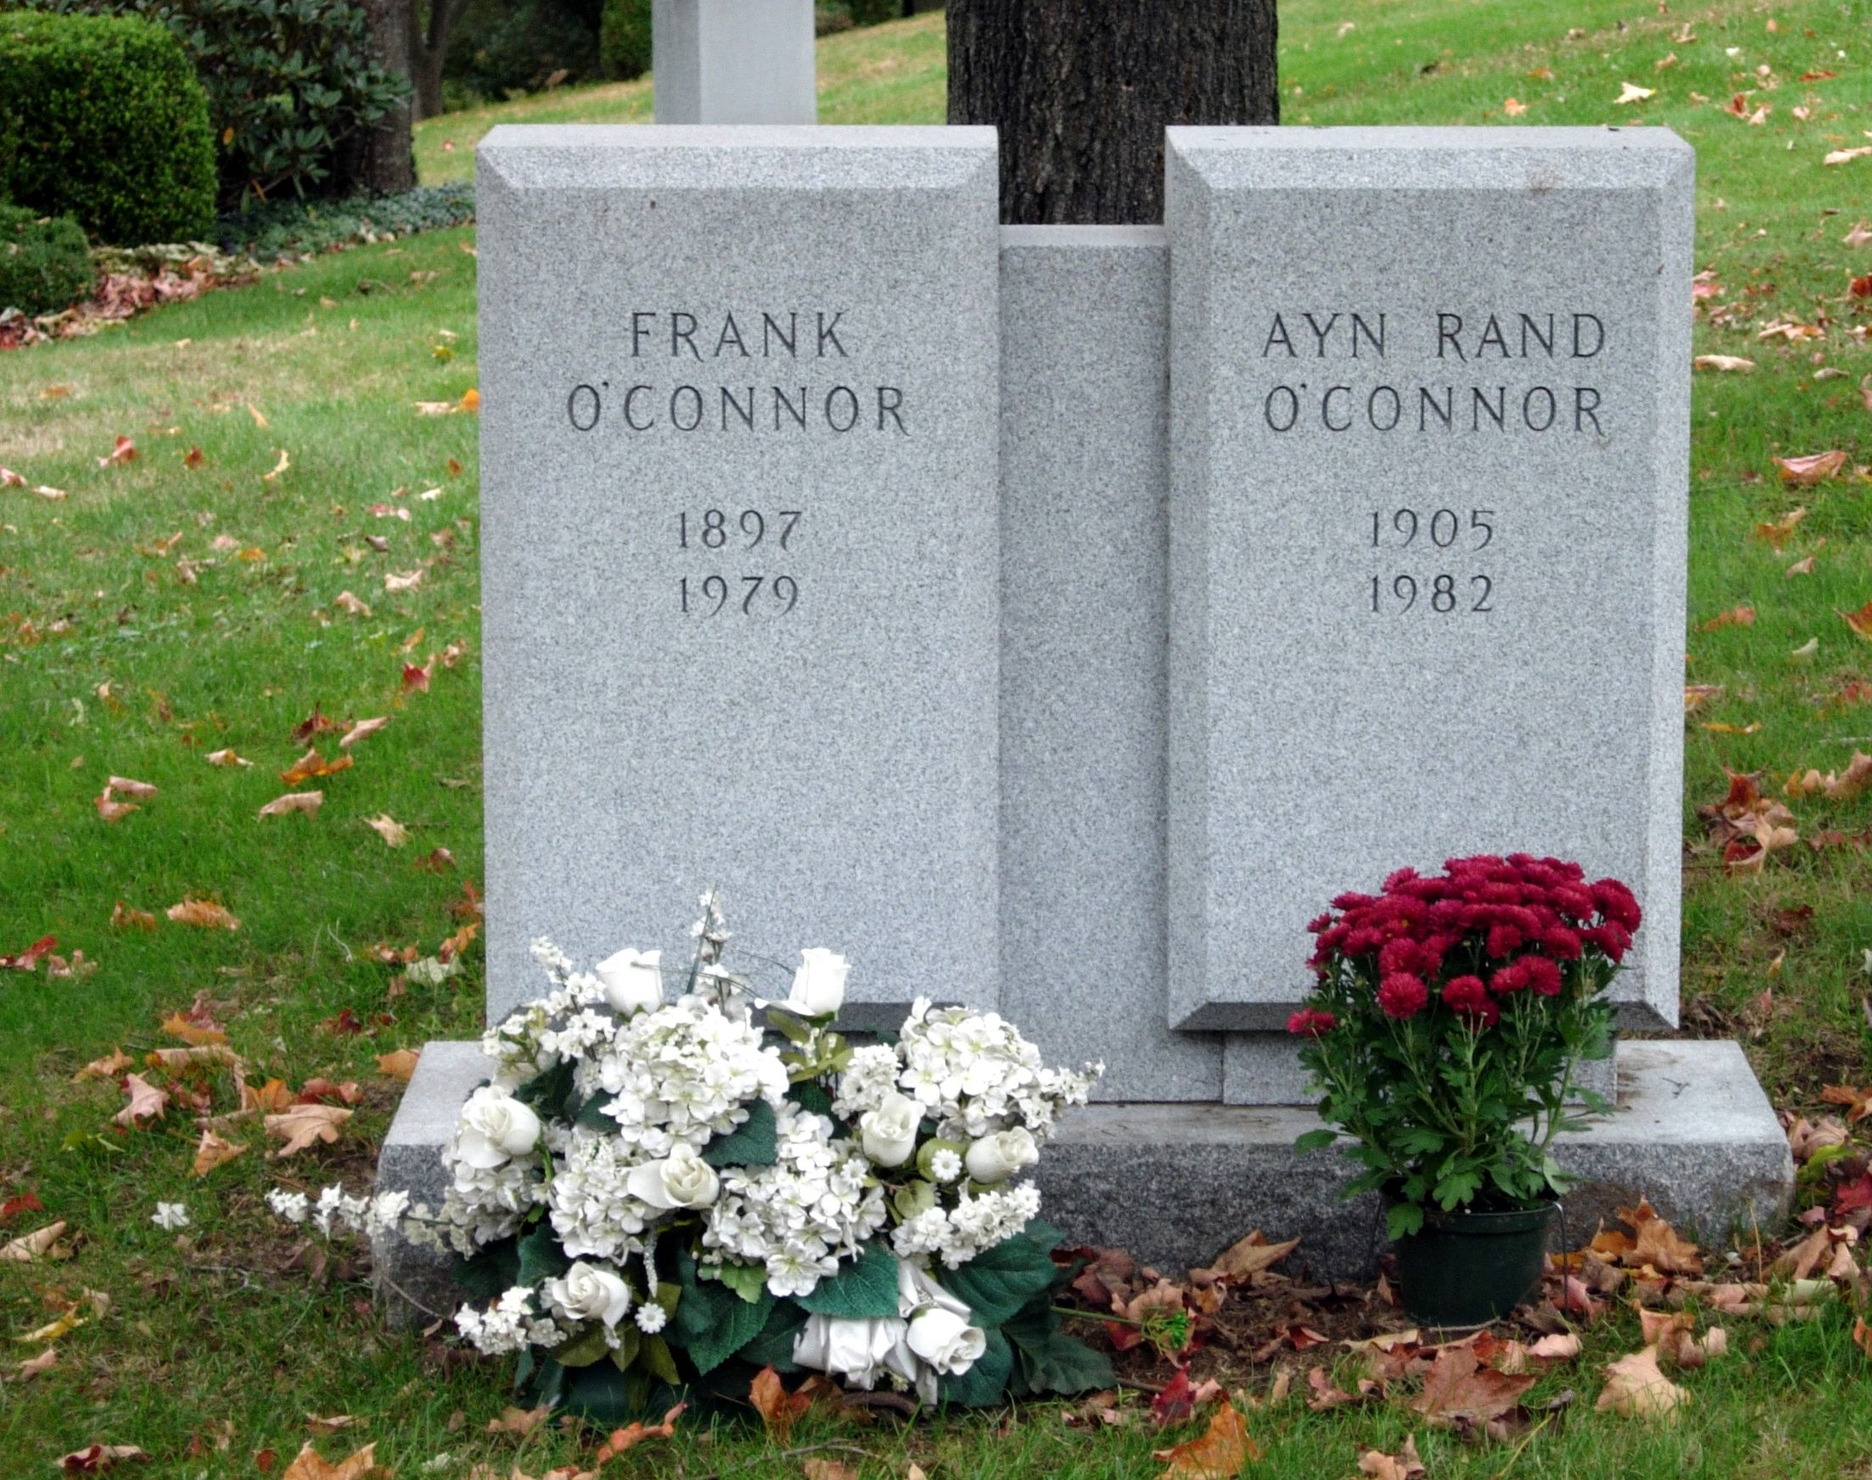
“It is not I who will die, it is the world that will end” – Ayn Rand
“So too at death the world does not alter, but comes to an end” – Ludwig Wittgenstein
How the idealism of youth can become the bitterness of old age.
Notes:
On March 6, 1982, Rand died of heart failure at her home in New York City.^{[118]} At her funeral, a 6-foot (1.8 m) floral arrangement in the shape of a dollar sign was placed near her casket.^{[119]} In her will, Rand named Peikoff as her heir.
Speak about my own experience of growing older
Potential effect on people who think they can change the World, but discover that they can’t.
Youthful idealism
Arrogance
Realising that no-one is paying attention
Bitterness
Doubling-down
Shouting louder in a foreign country, waving one’s flag harder, Luther, and others, can see this is JP, HC, etc.
Schisms with Collective members, such as NB, but many others. Increasingly cantankerous, intolerant and contradictory, various biographies hurt her image. Her husband Frank became senile and died, etc.

Slide 24

Further reading
The Fountainhead
Anthem
We The Living
Ayn Rand and the World She Made
Goddess of the Market: Ayn Rand and the American Right by Jennifer Burns
The Virtue of Selfishness
The Games People Play by Eric Berne
The Deepest Acceptance by Jeff Foster

Slide 25

Thank you
Q&A
Notes:
Pro-capitalism
Selfishness – upholds that the
Egoism
Homosexuality – like many of her generation, and afterwards, was disgusted by homosexuality, but supported people’s right to be homosexual. My father is the same as this.
Primitivism - https://en.wikipedia.org/wiki/Objectivism%27s_rejection_of_the_primitive
Environmentalism – believes it to be primitivist and against human endevor, but upholds the right of someone to be an environmentalist (?)
Was on social security and medicare
Racism - The lowest and most crudely primitive form of collectivism! The notion that a man’s intellectual and characterological traits are produced and transmitted by his internal body chemistry. The only solution to prevent [racism] is individualism and capitalism!
Therefore Rand’s philosophy is fundamentally non-Racist by definition. There is no way in the tenets of the philosophy that racism can be justified. Her argument would be that capitalism in it’s purest form with open-handed contracts and the objectivist respect for self-interest means that ….
AntiJudaism
----------------
Although Rand was born into a Jewish family, she renounced religion by saying that she was born Jewish but that she is in fact an atheist. I suspect she renounced religion because it didn’t make rational sense and it was not possible to draw a rational conclusion of its existence based on observation of the real world. She heavily rejected instinct, just knowing, intuition, revelation, mysticism.
A generally liberal stand-point:
“Putting it crudely: liberals, their political parties, their newspapers, and ideologies, emphasize the right to enter freely into contract and tended to orientate the power of the state towards enforcing those contracts, rather than limiting them. Conservative and reactionary parties embraced more corporatist views that represented unrestrained rights of contract as a threat to the right order (natural, moral, and divine) of society.”
However I suspect that some criticism of her, some suspicion will use age-old anti-Jewish tropes around contract law, money, the market etc. Her ethics very much follow this line. Throughout most of history, a large majority of thinkers have defined the evils of law, materialism, capitalism, lack of spirituality, along anti-Jewish lines, pouring all these undesirable qualities into the image of the Jew (such as that shown above, which uses the “birdman” character from The Temptation of Saint Anthony by Hieronymus Bosch, or Shakespeare's character of Shylock the Jew from the “Merchant of Venice”).
Kant was also an anti-Semite, believing that Jews were incapable of transcending material forces, which a moral order required. In this way, Jews are presented as the opposite of autonomous, rational Christians, and therefore incapable of being incorporated into an ethical Christian society. Perhaps this was where her vitriolic hate of Kant came from.
Ironically then, her championing of self-interest, rationality, the material, the sanctity of private property (enshrined in the French Republic’s Constitution) and contract, capitalism, are all traits used in antisemitism. We’re in dangerous territory here, because the criticism of the American economic system and the age-old criticism of the Judaization of Christianity are very compatible bed-fellows; it is something we need to be mindful of.
Until the apocalypse, the “spirit” will always depend on the same “carnal” tools that produce the imperfection of the world: tools like law, symbol, ritual, ceremony, money, contract, and language. The more imminent a politics makes its claims to the world’s perfection, and the more it stigmatises these tools, the more dangerous the paradox of their persistent survival becomes for that politics, and the more pressing the drive to destroy them.
Most social movements that aim for a new world order, or aim for a utopia, have this quandary: the system they are trying to replace is exactly the system they depend on for their existence and continued survival. It’s like cutting off one’s own oxygen supply.
On the Right
-----------------
Relating to the right: right libertarianism in the US. Though Rand was less socially conservative and did not champion exploitation of others.
Small state, anti-statism, anti-imperialism, Trump was anti-imperialistic in his politics. JP and acceptance taking responsibility for one’s own actions.
Odd to pick a picture of Sarah Palin as she is a neo-conservative rather than a libertarian.
Rand’s writings affected the right wing Young Americans for Freedom (YAF) splintering off into Libertarian, Objectivist, Minarchist, Anarchist and Anarcho-Capitalist factions.
Minarchists support the concept of the night-watchman state – Robert Nozick “Anarchy, State and Utopia” (1974)
Nachtwächterstaat coined by Ferdinand Lassalle in 1862 – in German the term also means incompetent or stupid.
There was some attempt to align the libertarian/objectivist movement with the New Left in the 1970s, as a lot of the ‘freedom’ orientated causes were the same – draft abolition, immediate withdrawal from Vietnam, equal rights for women, legalisation of gayness, porn, marajana, opposed to domestic statism – but the dividing line was the former supported capitalism.
Joke: If you put half a dozen libertarians in a room together, what do you get?
Answer: 4 factions, 2 conspiracies, 3 newsletters, 2 splinter groups, and 4 withdrawals of sanction!”

